Slide 1
Fred Meyer
Toni

Slide 2
Background
Founded by Fred G. Meyer
In portland oregon in 1908

Slide 3
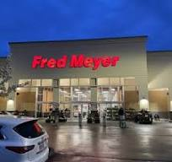
Industry
Retail industry

Slide 4
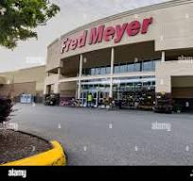
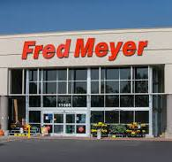
Is fred meyer publicly traded
no

Slide 5
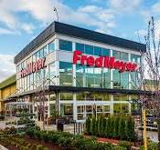
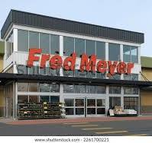
Is fred meyer producing revenue
Yes
Revenue in 2021 $5.5 billion

